Slide 1

Stock Market Prediction & Analysis
Project 4
Lexi Schroeder Soumik Sarkar Vlad Koledin
From Group 1:
Abigail Dichie Alexa Lutz Brittany Hammond Charly Ilunga

Slide 2



Context
Stock price prediction is crucial for investors aiming to make informed decisions
Prediction difficult in the tech sector, known for its volatility and rapid innovation cycles.
Accuracy challenges due to market fluctuations and external factors (e.g., economic news, earnings reports, and global events)
Our project focuses on predicting the stock prices of five influential technical companies and leaders: Apple, Amazon, Nvidia, Roku, and Microsoft.

Slide 3
APPROACH
Data Collection & Preparation
Data Engineering & Exploratory Analysis
Model Selection & Training
Visualization & Presentation
Historical stock data fetched via yfinance library API
Datapoints covered daily closing prices, volume and other financial indicators
Data cleansing handled missing values and normalized to ensure consistency across different stocks
Data engineering transformed & processed the raw data into a structured format for analysis
Exploratory analysis performed to understand key trends, such as stock price trends, volatility patterns, and trading volumes
Visualizations were created using Matplotlib and Seaborn to identify patterns (e.g., seasonal trends, significant events impacting stock prices)
Employed models like ARIMA for time-series forecasting, Random Forest for capturing complex patterns, and LSTM for handling sequential data
Technical indicators such as moving averages, RSI, & Bollinger Bands enhanced predictivity
Models trained & optimized using grid search and cross-validation to ensure robust performance
Combined Plotly for interactive visuals and Matplotlib/Seaborn for static charts to highlight key data insights
Visualizations & insights cohesively integrated into accessible format
Visuals were used to synthesize findings and clearly present actionable recommendations
01
02
03
04

Slide 4

LIMITATIONS
Data Collection Challenges:
Data Quality: Issues with missing values, outliers, and inconsistent data sources required extensive preprocessing.
Feature Limitations: Limited access to external influencing factors (e.g., macroeconomic indicators) constrained model inputs.
Model Limitations:
ARIMA: Struggled with non-linear patterns, leading to suboptimal performance in volatile markets.
LSTM: Required significant computational resources and risked overfitting due to model complexity.
Overfitting Risk: Due to the complexity of the models, particularly with deep learning approaches like LSTM, there was a risk of overfitting the training data
Other Limitations / Constraints:
Resource-Intensive: High demands on processing power and memory, leading to long training times and scalability issues
Market Volatility: External events and noise in financial data led to unpredictable market movements, challenging prediction accuracy.
Notes:
Technical Limitations
Challenges in Data Collection:
Data Quality Issues: Historical stock data often contained missing values, outliers, and anomalies, such as abrupt price changes due to stock splits or erroneous data entries. Addressing these issues required careful preprocessing, including imputation of missing values, filtering outliers, and correcting or removing erroneous data points.
Inconsistent Data Sources: Data obtained from different sources sometimes showed inconsistencies, such as variations in time zones, differing stock price calculations, or discrepancies in recorded trading volumes. These inconsistencies necessitated extensive normalization and alignment processes to ensure that the data was reliable and comparable across different stocks.
Limited Feature Availability: Certain external factors that could influence stock prices, such as macroeconomic indicators, industry-specific news, or social sentiment, were not readily available or were difficult to quantify, limiting the range of features that could be used in the models.
Model Limitations:
ARIMA Model Challenges: The ARIMA model, while effective for linear time-series data, struggled to capture non-linear patterns inherent in stock prices. This limitation made it less effective in predicting sudden market shifts or complex dependencies between variables, leading to suboptimal performance in highly volatile markets.
LSTM Model Constraints: While LSTM models are well-suited for capturing sequential dependencies, they required substantial computational resources, especially when dealing with large datasets and multiple features. This increased the training time significantly and necessitated the use of high-performance computing resources, which may not always be accessible.
Overfitting Risk: Due to the complexity of the models, particularly with deep learning approaches like LSTM, there was a risk of overfitting the training data, especially when the models were exposed to noise or too many irrelevant features. Overfitting can result in poor generalization to new data, leading to inaccurate predictions.
Computational Constraints:
Resource-Intensive Training: The training process for deep learning models, particularly LSTM, was computationally expensive, requiring significant processing power and memory. This was especially challenging when working with long time-series data or when trying to optimize hyperparameters through techniques like grid search.
Long Training Times: The complexity of the models, combined with the size of the datasets, resulted in long training times, which slowed down the iterative process of model refinement and validation. This constraint made it difficult to experiment with multiple models and configurations within a limited timeframe.
Scalability Issues: Scaling the models to handle multiple stocks simultaneously added further strain on computational resources, potentially requiring parallel processing or distributed computing techniques to manage the workload efficiently.
Market Volatility:
Sudden Market Shifts: External factors such as earnings reports, geopolitical events, and unexpected economic news introduced abrupt changes in stock prices that were difficult for the models to predict accurately. These sudden shifts often led to significant deviations between predicted and actual prices, reducing the overall reliability of the predictions.
Noise in Financial Data: Financial markets are inherently noisy, with prices influenced by a wide range of unpredictable factors, including investor sentiment, speculative trading, and market rumors. This noise can obscure underlying trends and make it challenging for models to differentiate between short-term fluctuations and long-term patterns.
Dynamic Market Conditions: The models were trained on historical data, which may not fully capture the evolving dynamics of the market. As market conditions change, the relevance of past data diminishes, potentially leading to outdated or inaccurate predictions if the models are not frequently retrained and updated.

Slide 5

Deep Dive: Individual Stock Analysis
Amazon
Apple
Microsoft
Nvidia
Roku

Slide 6
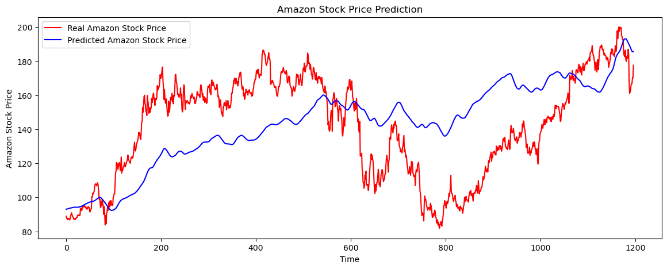
DEEP DIVE: Amazon (AMZN)
EDA Insights: Amazon’s stock exhibited rapid growth, especially during the holiday seasons and major sales events like Prime Day.
Model Performance: Provides some predictive capability, particularly in capturing general trend, it is not sufficiently accurate for detailed predictions, and further refinement would be necessary for it to be useful in a real-world setting.
Key Takeaways:
Amazon’s stock price is highly sensitive to consumer trends & economic conditions, making it a strong but volatile investment.
Metric | Value | Amazon Summary
Final Mean Squared Error (MSE) | 879.26 | High MSE indicates significant deviations between predicted and actual prices.
Final Root Mean Squared Error (RMSE) | 29.65 | Predictions are, on average, off by about $29.65, showing notable error.
Final Mean Absolute Error (MAE) | 25.88 | On average, predictions deviate from actual prices by $25.88
Final R-squared (R2) Score | 0.037 | Very low R2 score suggests the model poorly explains the variability in Amazon's stock prices.

Slide 7
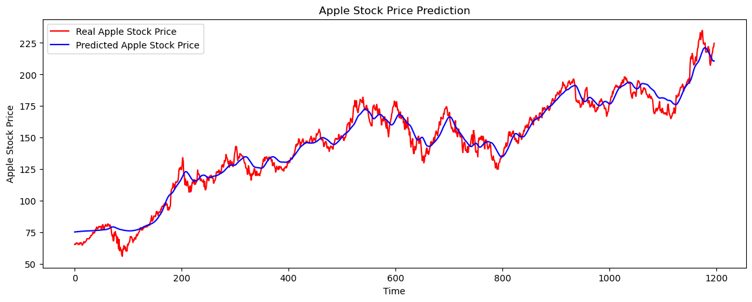
DEEP DIVE: Apple (AAPL)
EDA Insights: Apple's stock exhibited strong seasonal trends, with significant price increases around product launches and earnings reports.
Model Performance: The model provides some predictive capability, particularly in capturing the overall trend of Apple's stock price.However, it struggles with accurately predicting short-term fluctuations, indicating the refinement needed to improve its reliability.
Key Takeaways:
Apple's stock price is heavily influenced by product launches and market sentiment, making it somewhat predictable but also subject to volatility.
Metric | Value | Apple Summary
Final Mean Squared Error (MSE) | 44.15 | Indicates relatively low average squared error; the model captures the overall trend well.
Final Root Mean Squared Error (RMSE) | 6.64 | Predictions are, on average, off by about $6.64, showing reasonable accuracy.
Final Mean Absolute Error (MAE) | 5.29 | On average, predictions deviate from actual prices by $5.29, indicating good precision.
Final R-squared (R2) Score | 0.969 | High R2 score indicates 96.9% of the variance in Apple's stock prices, reflecting strong model performance.

Slide 8
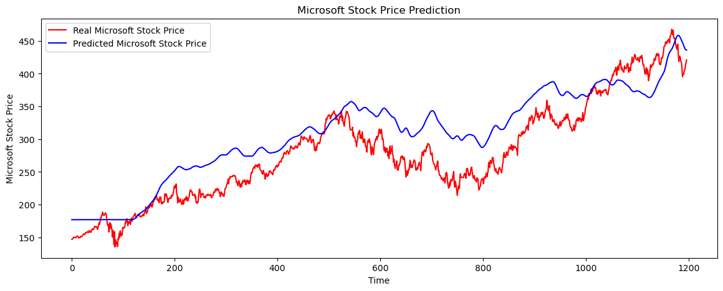
DEEP DIVE: Microsoft (MSFT)
EDA Insights: Microsoft demonstrated steady growth, with occasional spikes around major announcements & earnings reports.
Model Performance: The model effectively captures the overall trend of Microsoft’s stock price but struggles with short-term predictions, particularly during periods of high volatility.
Key Takeaways:
Microsoft’s stock is generally stable but influenced by product releases and market sentiment, making it a solid investment with moderate risk.
Metric | Value | Microsoft Summary
Final Mean Squared Error (MSE) | 1630.53 | Relatively high error when predicting MSFT stock price, indicating significant deviations from actual prices.
Final Root Mean Squared Error (RMSE) | 40.38 | On average, the predictions are off by about $40.38, reflecting moderate accuracy but with room for improvement.
Final Mean Absolute Error (MAE) | 35.22 | Average deviation between predicted & actual stock prices is $35.22, suggesting predictions & actuals not closely aligned
Final R-squared (R2) Score | 0.717 | Model explains approximately 71.7% of the variance, indicating decent performance but missing a significant portion of the variance.

Slide 9
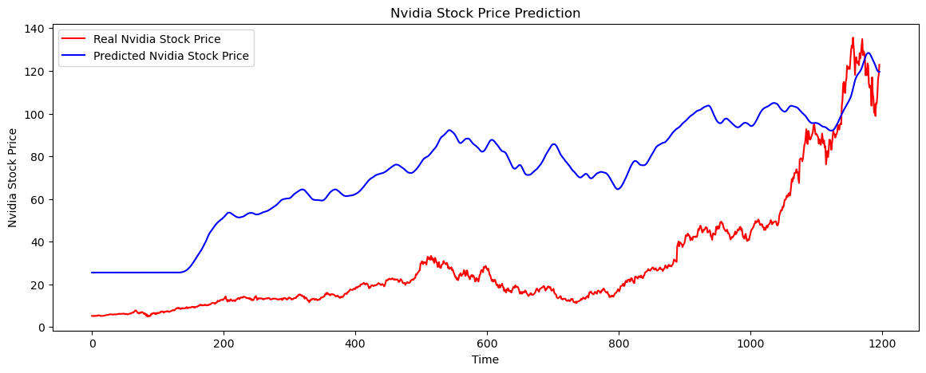
DEEP DIVE: Nvidia (NVDA)
EDA Insights: NVIDIA's stock was significantly impacted by trends in the gaming industry and advancements in AI, with notable volatility around product releases.
Model Performance: The model effectively captures the general trends of NVIDIA’s stock price but struggles with predicting sharp movements and volatility typical in the tech sector.
Key Takeaways:
NVIDIA’s stock is a strong indicator of the tech sector's health, particularly in gaming & AI, but is susceptible to rapid changes based on market trends.
Metric | Value | Nvidia Summary
Final Mean Squared Error (MSE) | 2170.42 | Indicates significant deviations between predicted and actual prices, suggesting the model struggled to predict accurately.
Final Root Mean Squared Error (RMSE) | 46.59 | The average prediction error is approximately $46.59, reflecting poor accuracy in predicting stock prices.
Final Mean Absolute Error (MAE) | 43.14 | On average, predictions deviate from actual prices by $43.14 indicating large errors in the model's predictions.
Final R-squared (R2) Score | -1.72 | The negative R-squared value indicates that the model performs worse than a simple horizontal line (mean of actual prices), highlighting a very poor fit.

Slide 10
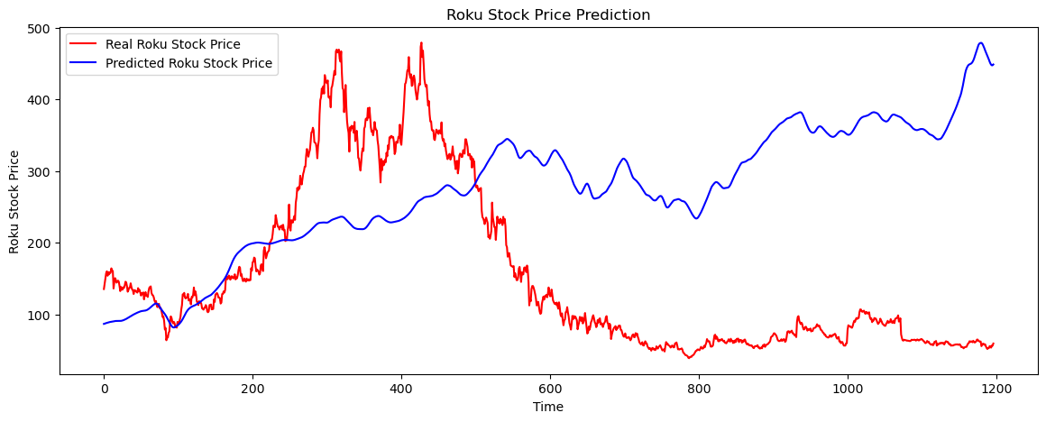
DEEP DIVE: Roku (ROKU)
EDA Insights: Roku’s stock showed high volatility, driven by competition in the streaming market & changes in consumer preferences.
Model Performance: The model captures some general trends in Roku’s stock price but struggles significantly with the high volatility and rapid changes typical in this market.
Key Takeaways:
Roku’s stock is highly unpredictable due to market competition and technological shifts in streaming, making it a risky but potentially rewarding investment.
Metric | Value | Roku Summary
Final Mean Squared Error (MSE) | 41111.6 | Model has very large errors in predicting Roku's stock price, indicating significant deviations from the actual prices.
Final Root Mean Squared Error (RMSE) | 202.76 | The average prediction error is approximately $202.76, reflecting very poor accuracy in predicting stock prices.
Final Mean Absolute Error (MAE) | 171.25 | On average, predictions deviate from actual prices by $171.25, indicating that the model is highly inaccurate.
Final R-squared (R2) Score | -2.07 | The negative R-squared value suggests the model performs worse than a simple horizontal line (mean of actual prices), indicating a very poor fit.

Slide 11
Comparison: Multiple Stock Analysis

Slide 12
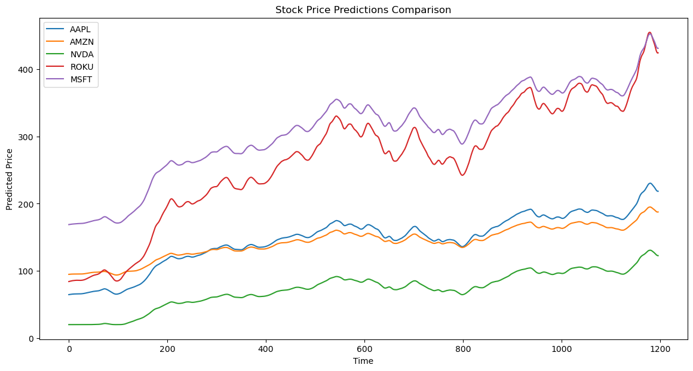
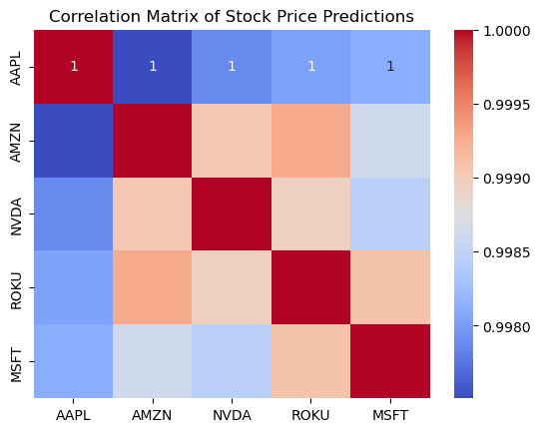
Comparison & Correlation
Comparison of Stocks
Nvidia and Amazon showed the highest growth rates
Microsoft and Apple demonstrated more stability
Roku was the most volatile stock, reflecting its exposure to market competition
Correlation of Stocks
A correlation matrix revealed moderate to high correlations between the stocks,
Companies with overlapping market segments, like Microsoft and Apple, saw increased correlation
Statistic | AAPL | AMZN | NVDA | ROKU | MSFT
Mean | 146.91 | 142.58 | 72.67 | 265.75 | 308.04
Std | 38.41 | 23.78 | 26.63 | 88.55 | 66.70
Min | 64.69 | 93.84 | 20.08 | 84.14 | 168.85
25% | 131.91 | 129.84 | 60.58 | 221.93 | 274.62
50% | 151.23 | 144.56 | 74.66 | 274.48 | 315.18
75% | 176.63 | 161.23 | 94.62 | 335.38 | 361.66
Max | 230.41 | 195.01 | 130.74 | 454.82 | 452.55

Slide 13
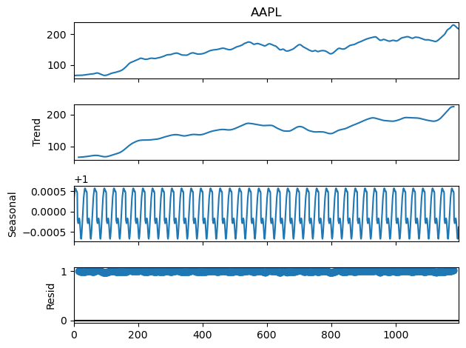

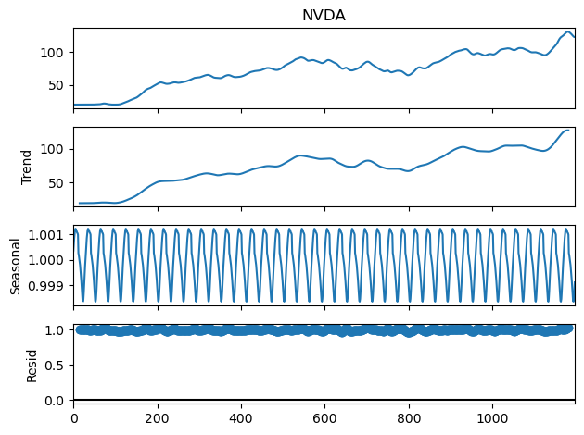
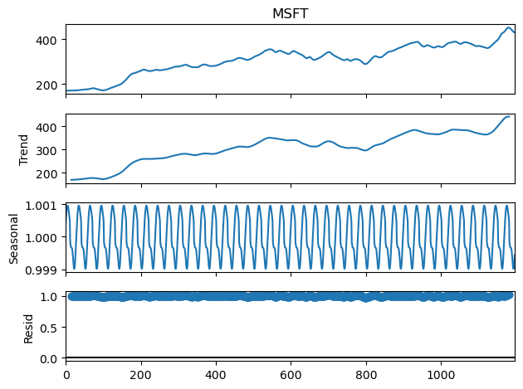
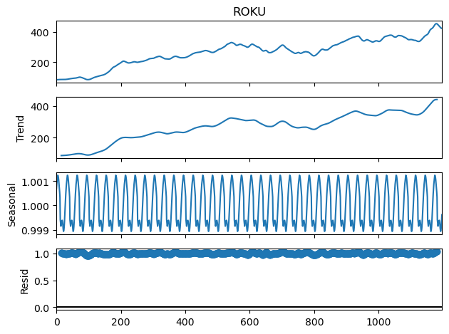
Time Series Analysis
Trend: All companies show a general upward trend, indicating that their stock prices have been increasing over the observed period. The exact shape of the trend varies, reflecting different growth rates and pattern
Seasonal: The seasonal component shows regular patterns in the data, which could be due to various factors like quarterly earnings reports, seasonal product launches, or other cyclical business activities.
Residual: The residuals should ideally resemble white noise, meaning that they are random with no discernible pattern. If there are patterns in the residuals, it suggests that the model might be missing some components or that the data has additional complexities not captured by the trend and seasonal components.
Summary: While all stocks generally trended upwards, each had a distinct volatility patterns, with tech giants like Microsoft and Apple showing resilience against market fluctuations.

Slide 14



Summary
The tech sector continues to demonstrate strong growth, but the varying volatility across these stocks suggests a need for diversified investment strategies.

Slide 15

Recommendations
Investment Recommendations:
For conservative investors, Microsoft & Apple offer stability with steady growth.
Risk-tolerant investors consider Nvidia or Amazon, given potential for high returns
Roku NOT recommended unless very high-risk tolerance due to its volatile nature
Model Enhancement Suggestions:
Future work could involve hybrid models combining ARIMA and LSTM to capture both short-term and long-term trends more effectively.
Incorporating external factors such as economic indicators and news sentiment could further improve prediction accuracy.
Strategic Insights:
Diversification across these stocks could mitigate risks, particularly in volatile market conditions.
Continuous monitoring and model retraining are essential to adapt to market changes and maintain prediction accuracy.
About Stock

Slide 16

About Stock
Thank you

